Slide 1
Data Analytics & Visualization
T.E. AI and DS - Jan 2023
Dr. M. Vijayalakshmi

Slide 2
Module 4 Text Analytics
History of text mining, Roots of text mining
Overview of seven practices of text analytics
Application and use cases for Text mining:
extracting meaning from unstructured text
Summarizing Text.

Slide 3
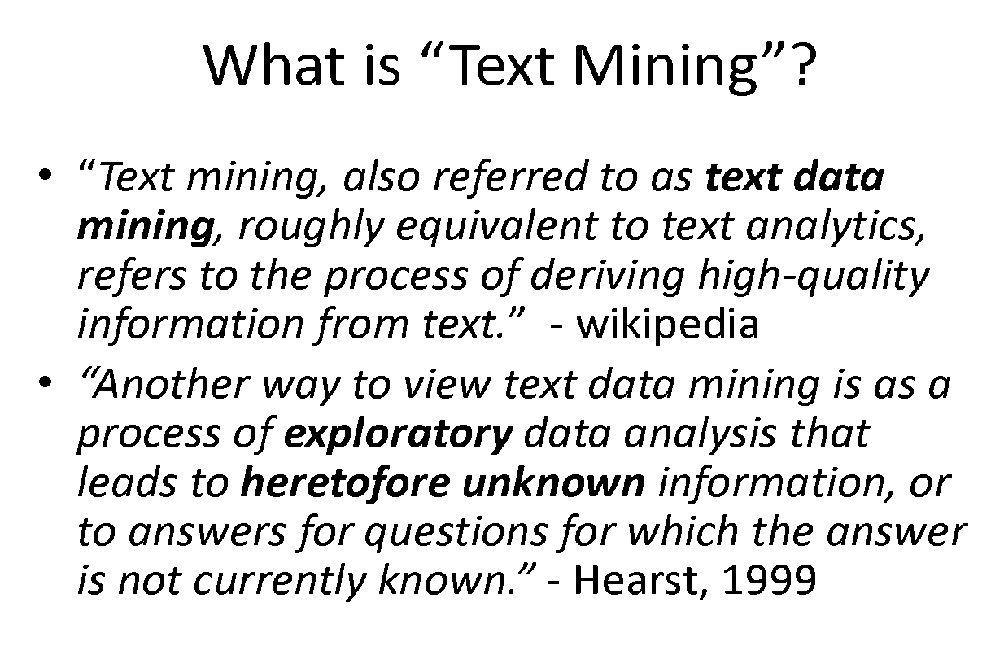

Slide 4
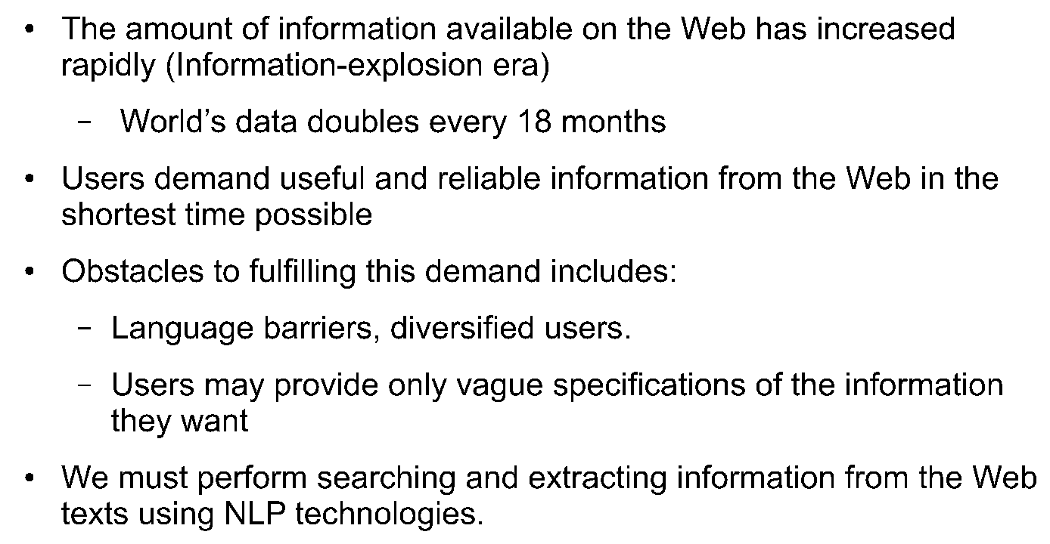
Motivation

Slide 5
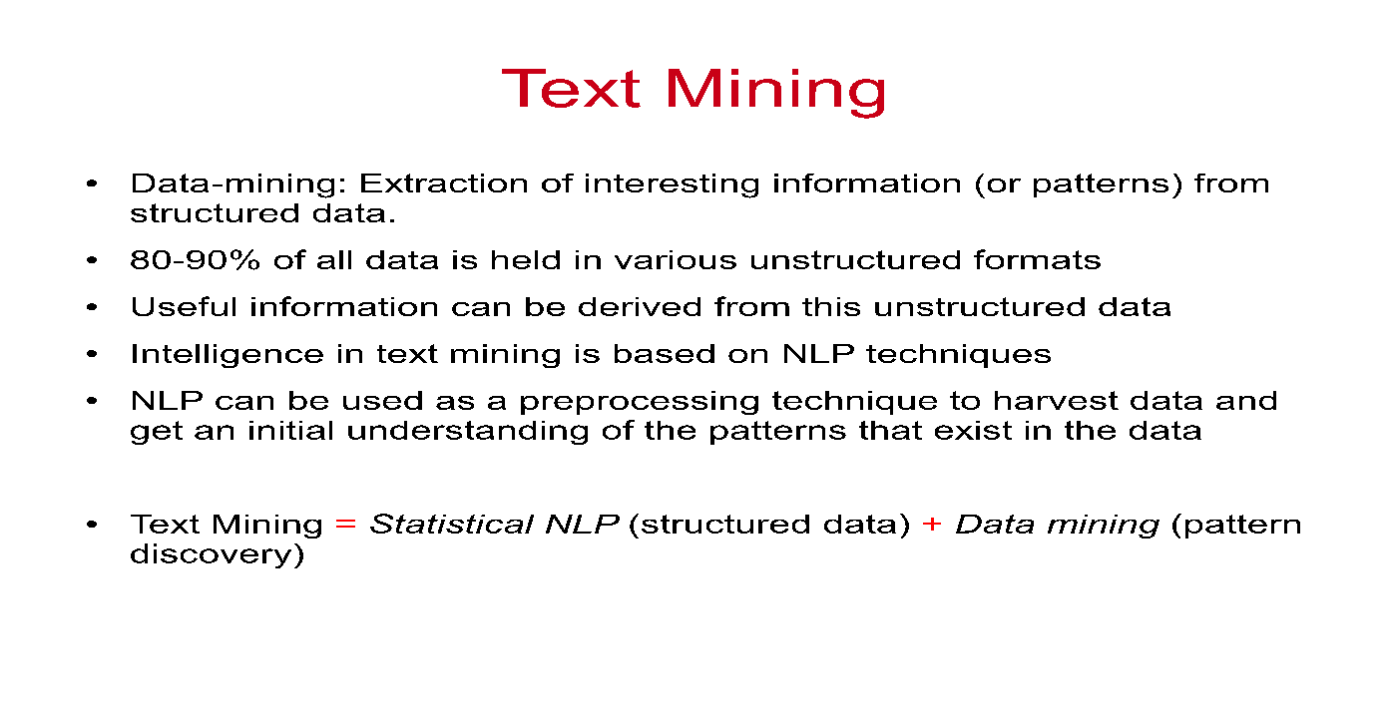
Motivation

Slide 6
Introduction
Text mining can be described as the process of extracting essential data from standard language text.
All the data that we generate via text messages, documents, emails, files are written in common language text.
Text mining is primarily used to draw useful insights or patterns from such data.

Slide 7
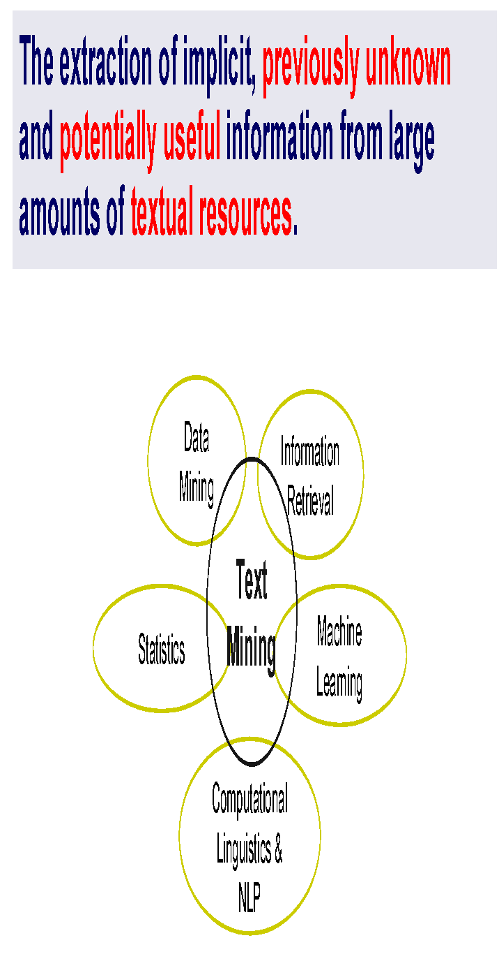
Text Mining

Slide 8
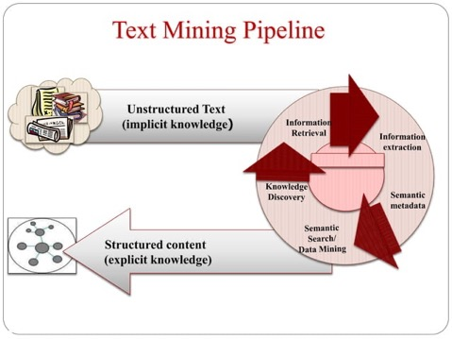

Slide 9
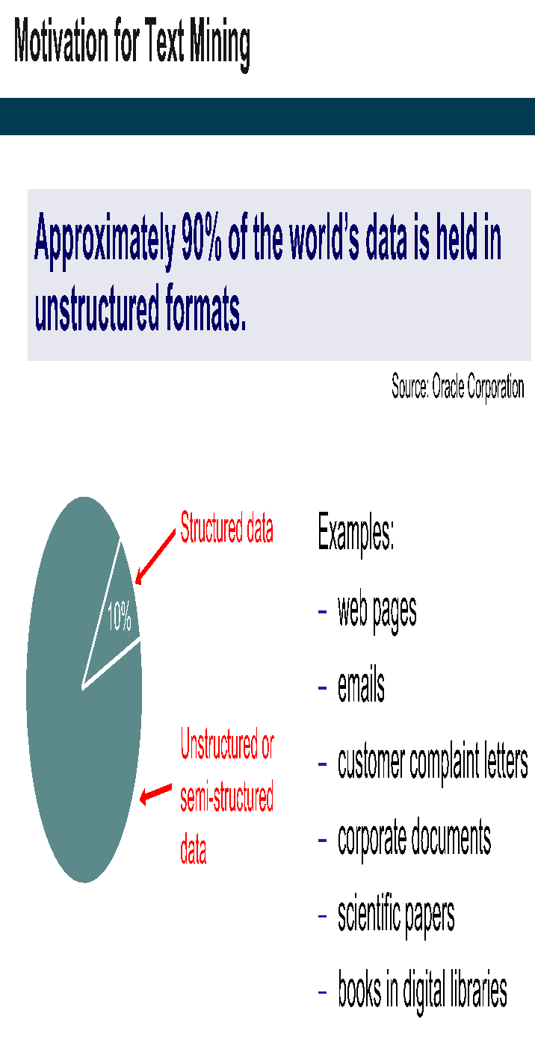

Slide 10
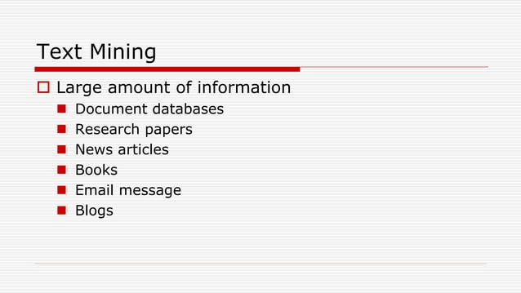

Slide 11
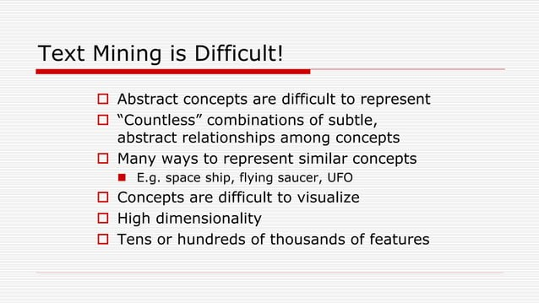

Slide 12
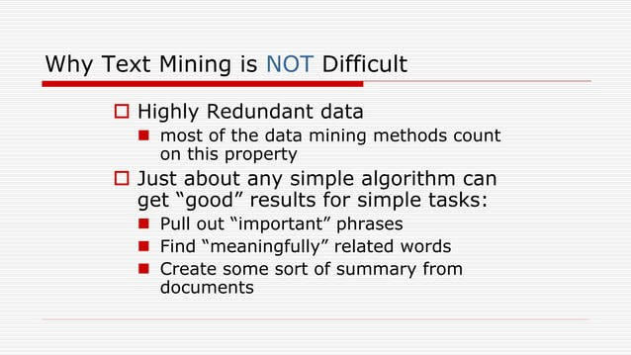

Slide 13
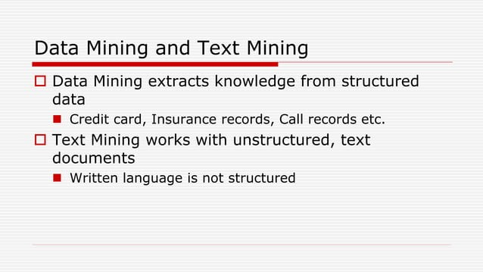

Slide 14
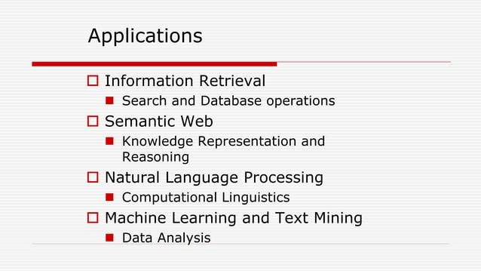

Slide 15
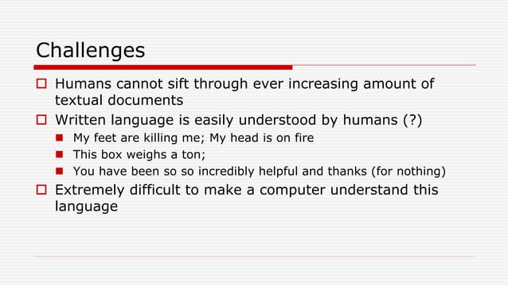

Slide 16
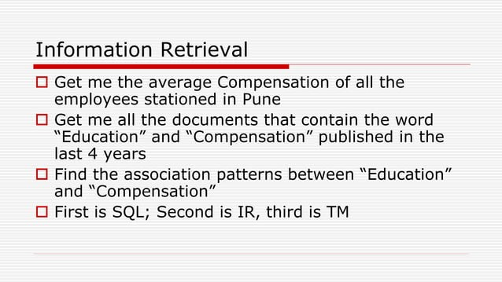

Slide 17
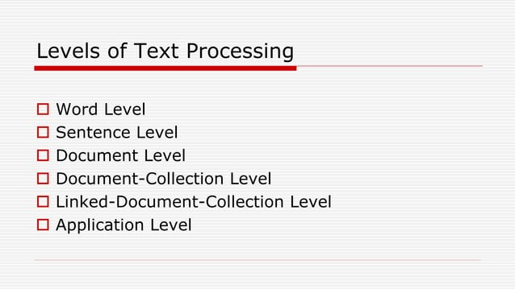

Slide 18
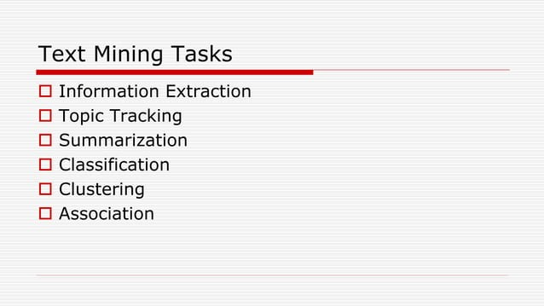

Slide 19
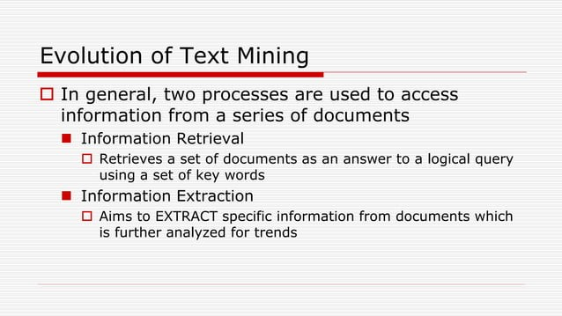

Slide 20
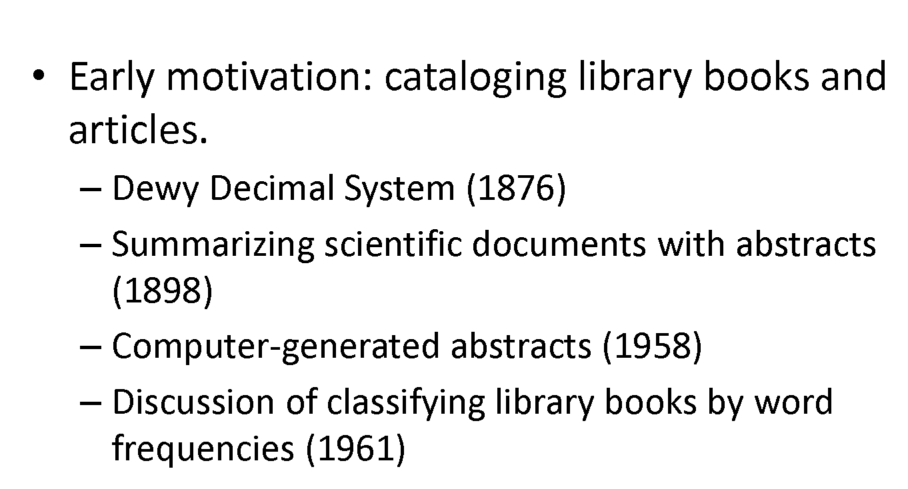
History

Slide 21
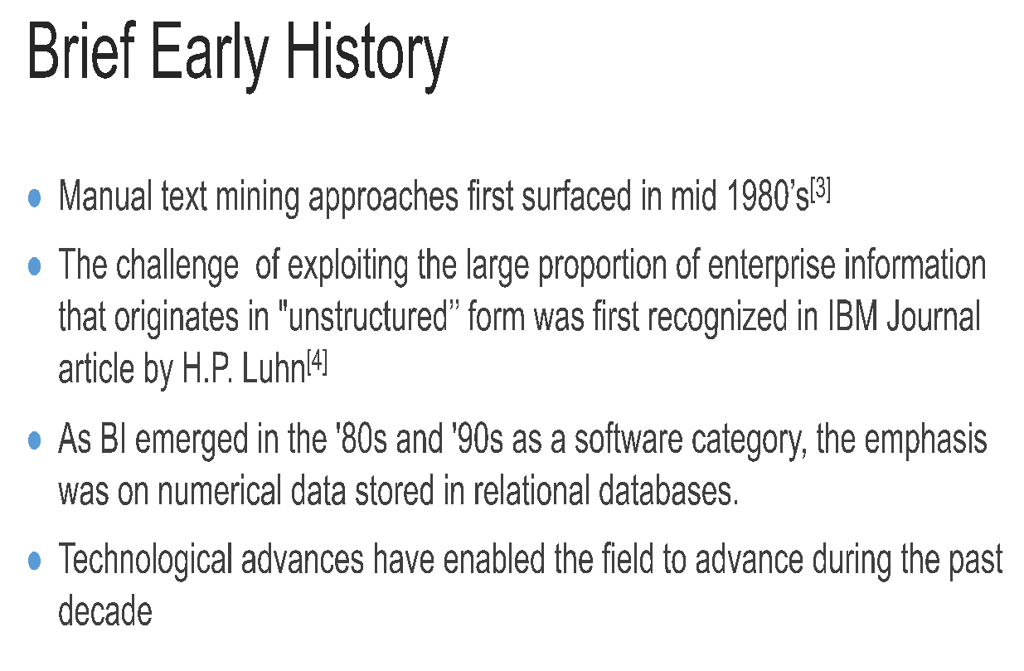

Slide 22
First Text Mining Approaches
Library science for text summarization and classification
Information science
Natural language processing

Slide 23
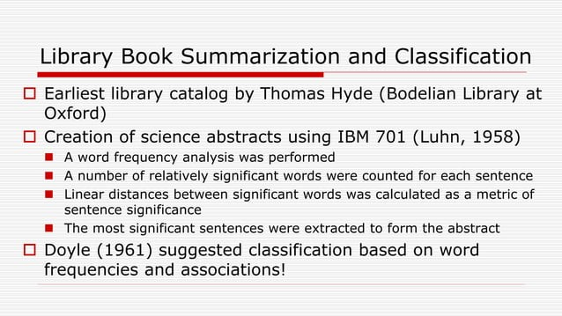

Slide 24
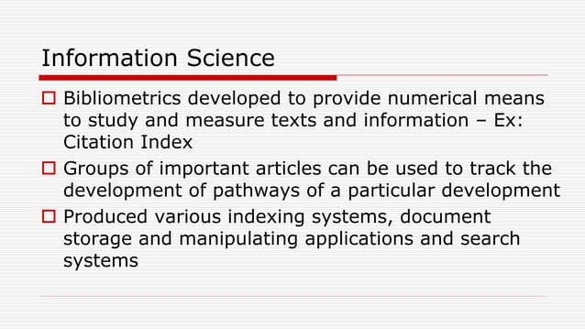

Slide 25
Roots of Text Mining
Many developments in technology and applications contributed to the modern text analysis systems.
Information retrieval- (IR) returns relevant information or documents based on a pre-defined set of queries or phrases.
IR systems distinguishes a set of documents as an answer to a logical query using a set of key words, possibly augmented by a thesaurus.
IR systems utilize algorithms to track user behaviors and identify relevant data.
Information retrieval is commonly used in library catalogue systems and popular search engines, like Google.

Slide 26
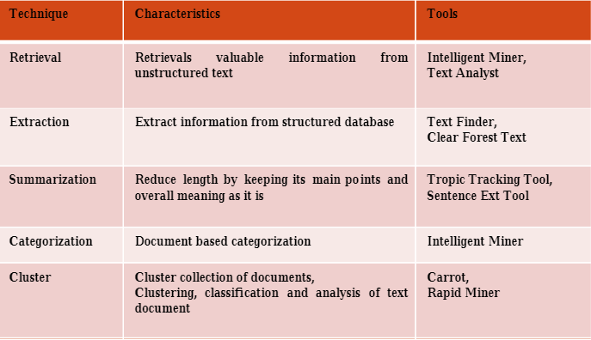
Roots of Text Mining
Information extraction (IE) surfaces the relevant pieces of data when searching various documents.
It also focuses on extracting structured information from free text and storing these entities, attributes, and relationship information in a database.
Information extraction, aims to extract from documents specific information that is then analyzed for trends or other data.

Slide 27
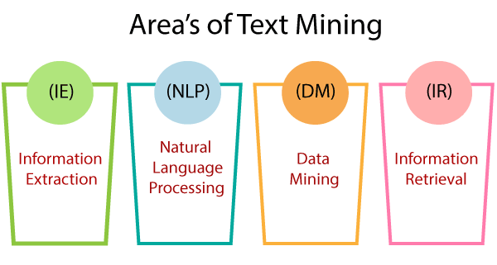
Roots of Text Mining

Slide 28
Roots of Text Mining
Text mining has its roots in three processes, information retrieval, extraction and summarization.
Library science: Library catalogue is the earliest example of text summarization. The first catalogue was developed by Thomas Hyde in 1864 for the Bodleian Library at the University of Oxford.
Information science: Before the advent of the computer, the information has to be catalogued and indexed in form of catalogue card and the library users have to go through the laborious task of finding the required information.

Slide 29
Roots of Text Mining
Natural language processing: This term is often used as a synonym for computational linguistics.
The major development in natural language processing is the machine learning technology to create parsing algorithms, which split words into tokens; and stemming algorithms, which reduce words to stems.
Clustering is an automated process which clusters the documents on the base of similarities.

Slide 30
Natural Language Processing (NLP)
NLP, which evolved from computational linguistics, uses methods from CS, AI, linguistics, & data science, to enable computers to understand both written and verbal forms. NLP sub-tasks allow computers to “read”.
Summarization: synopsis of long pieces of text to create a concise, coherent summary of a document’s main points.
Part-of-Speech (PoS) tagging: assigns a tag to every token in a document based on its part of speech—i.e. denoting nouns, verbs, adjectives, etc. This step enables semantic analysis on unstructured text.
Text categorization/ classification, is responsible for analyzing text documents and classifying them based on predefined topics or categories. particularly helpful when categorizing synonyms and abbreviations.
Sentiment analysis: detects positive or negative sentiment, allowing you to track changes in customer attitudes over time. Commonly used to provide info about perceptions of brands, products, services. These insights can help to connect with customers and improve processes and user experiences.

Slide 31
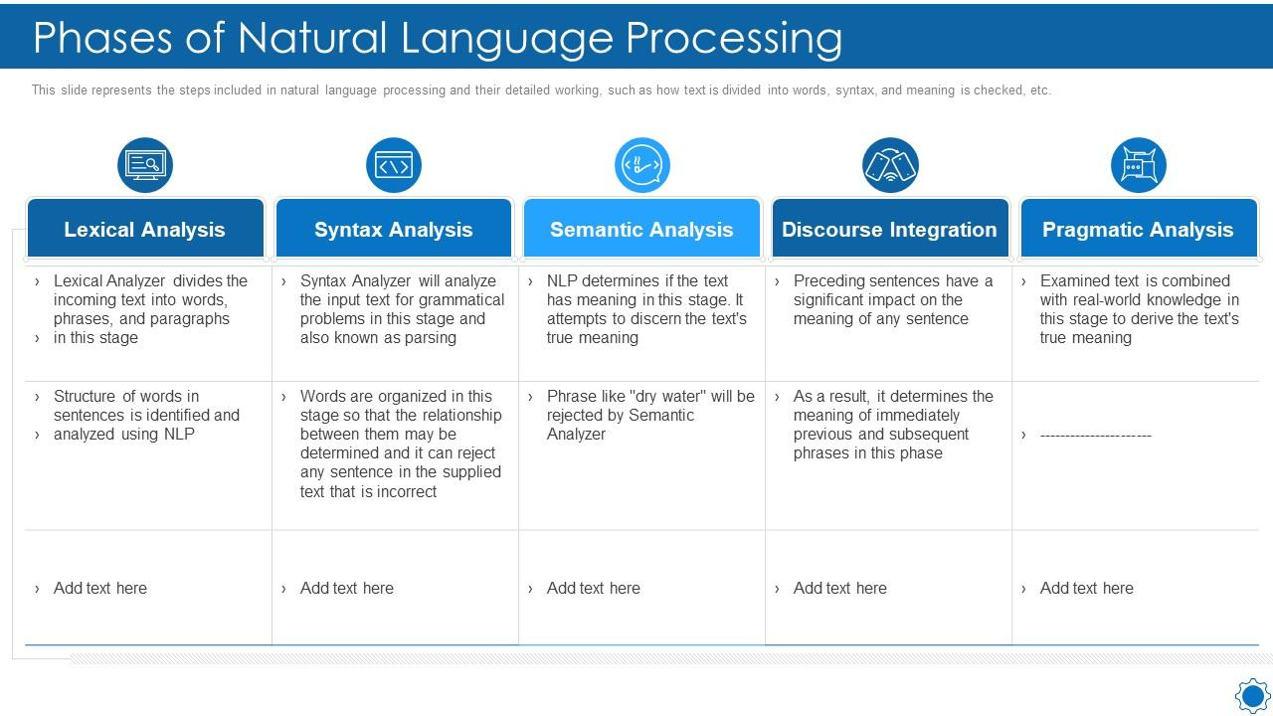

Slide 32
Information extraction
Information extraction (IE) surfaces the relevant pieces of data when searching various documents.
It also focuses on extracting structured information from free text and storing these entities, attributes, and relationship information in a database.
Common information extraction sub-tasks include:
Feature selection, or attribute selection, is the process of selecting the important features (dimensions) to contribute the most to output of a predictive analytics model.
Feature extraction is the process of selecting a subset of features to improve the accuracy of a classification task. This is particularly important for dimensionality reduction.
Named-entity recognition (NER) also known as entity identification or entity extraction, aims to find and categorize specific entities in text, such as names or locations. For example, NER identifies “Mumbai” as a location and “Hari” as a person’s name.

Slide 33
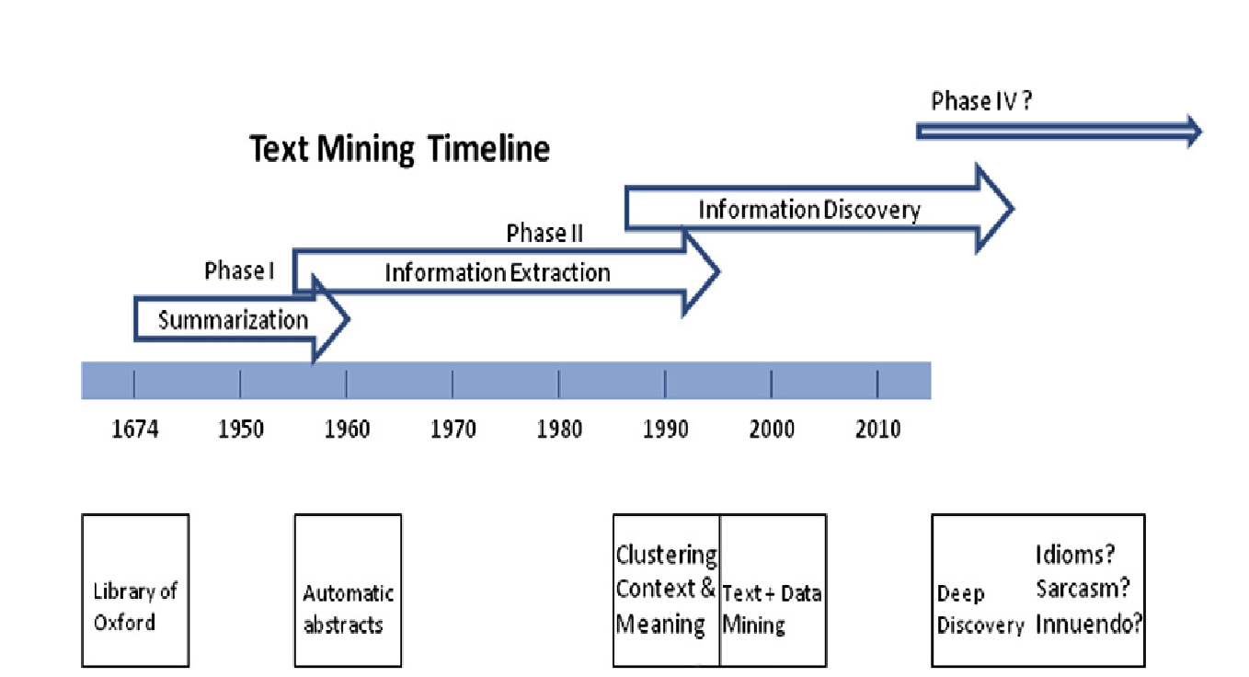

Slide 34
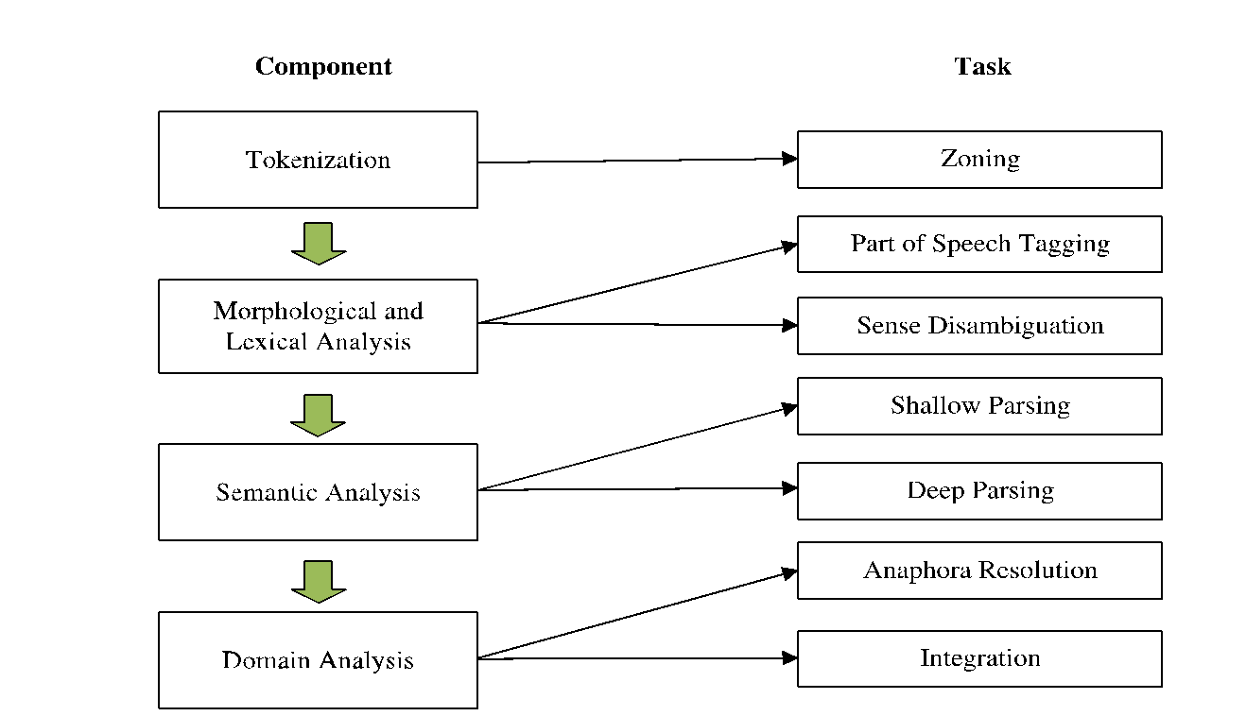
Some innovations in Text Mining
Modern Information Extraction Engines

Slide 35
Innovations in Text Mining
Rajman and Besancon (1998) describe the adaptation of Agarwal’s a priori market basket algorithm to the analysis of text data.
Feldman and Sanger (2007) define a frequent set as a collection of concepts extracted from a collection of documents that have a co-occurrence above a minimum level of support. In a natural language application, support is defined as the number or percent of documents associated with a certain rule. Associated with the support value is the confidence, which is defined as the percentage of time that the rule is true.
An early work by Hayes et al. (1988) presented a system for classifying text in news stories.
Another early application of text classification was used to classify text in images using word-length distributions (Hull and Li, 1993).

Slide 36
Innovations in Text Mining
A system for classifying web pages was proposed by Attardi et al. (1999).
In classical data mining circles, one of the seminal papers on discovery text mining was presented by Dörre and colleagues (1999) in the Industrial Track at the KDD-99 conference on Knowledge Discovery and Data Mining. This paper highlighted the use of the new IBM Intelligent Miner for Text toolkit to illustrate the distinction between text mining and traditional data mining.
The primary focus of their discussion was on summarization, feature extraction, and the classification of documents (all information retrieval and processing activities in early text mining efforts),

Slide 37
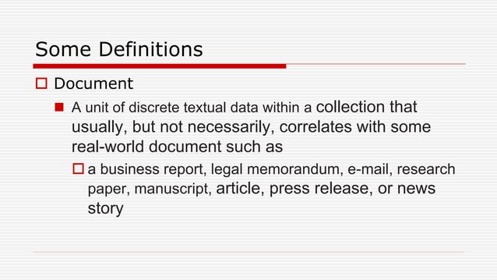

Slide 38
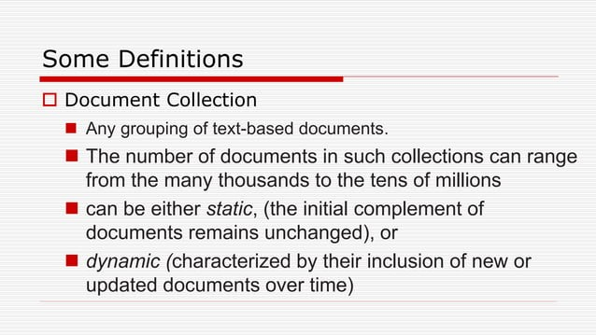

Slide 39
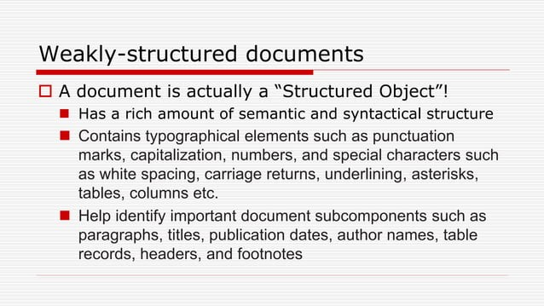

Slide 40
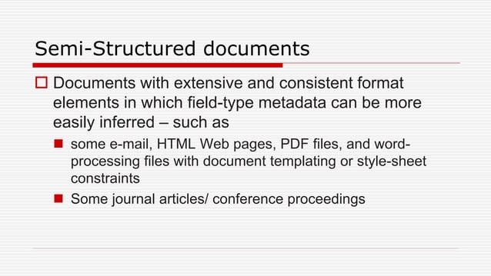

Slide 41
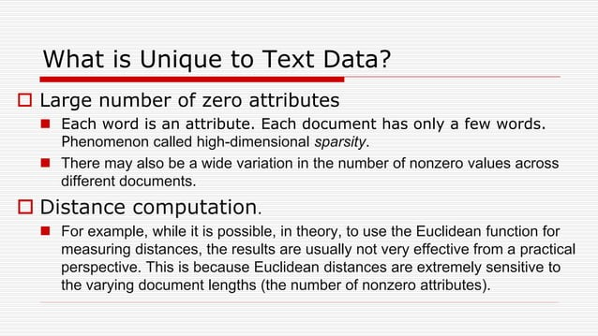

Slide 42
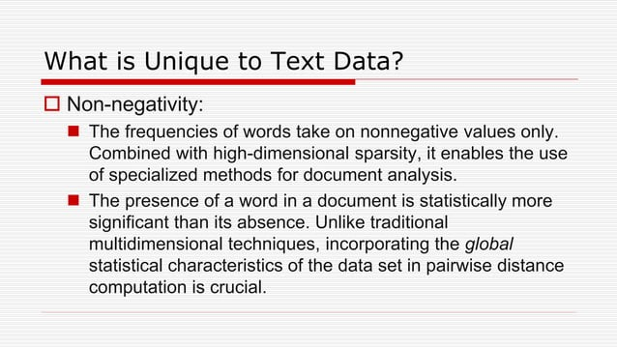

Slide 43
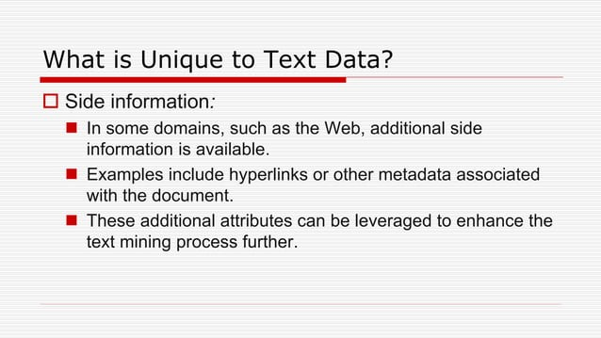

Slide 44
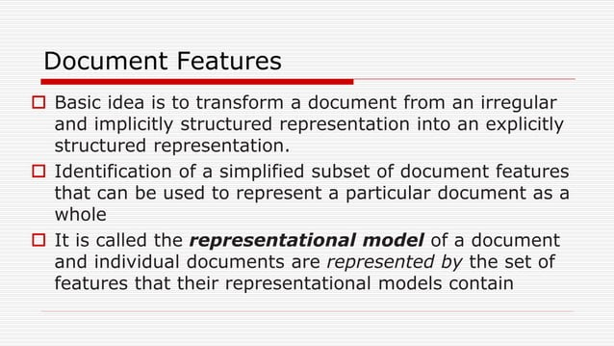

Slide 45
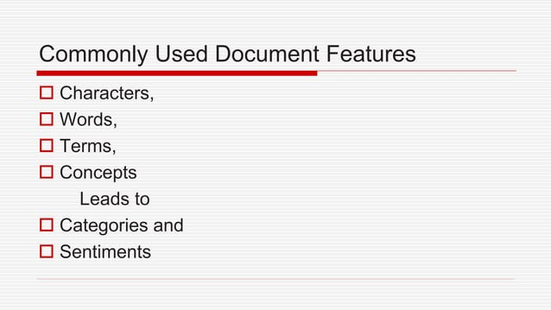

Slide 46
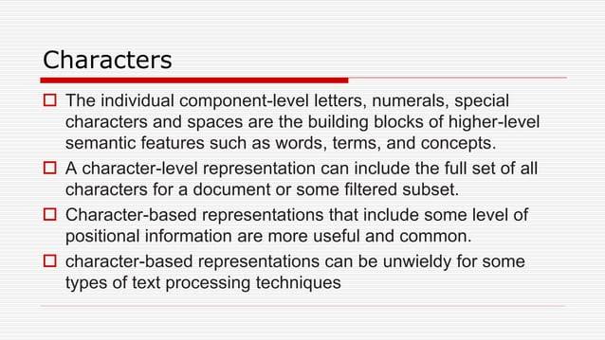

Slide 47
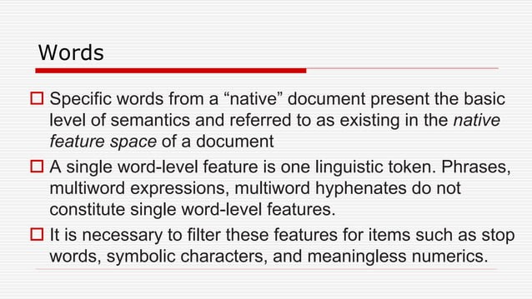

Slide 48
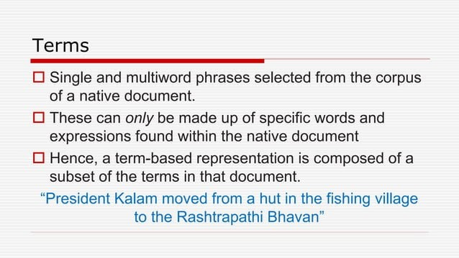

Slide 49
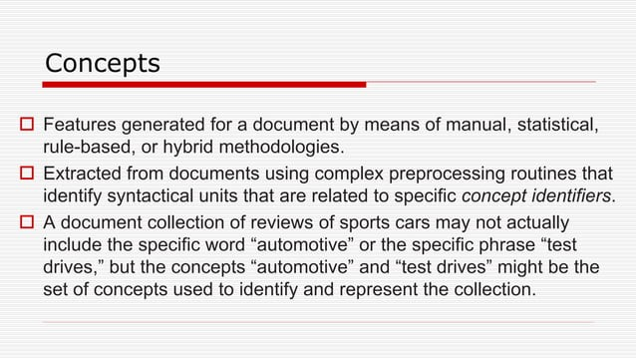

Slide 50
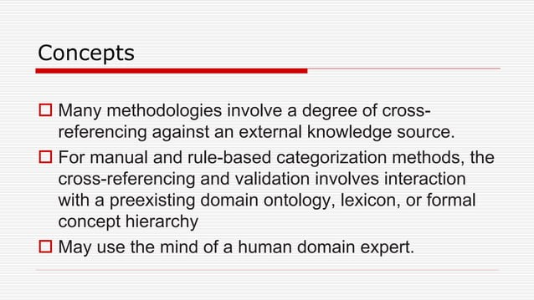

Slide 51
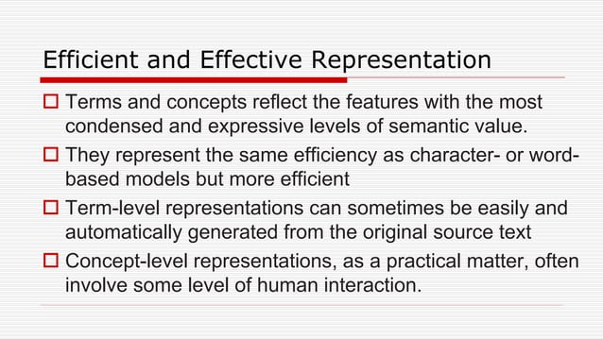

Slide 52
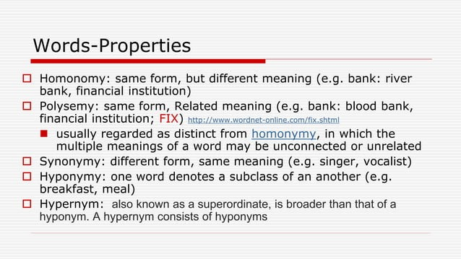

Slide 53
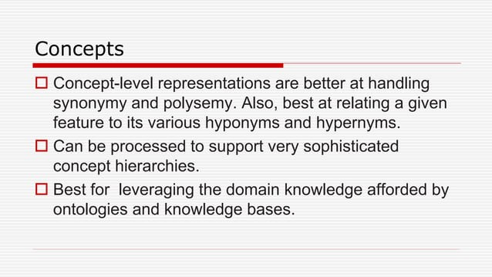

Slide 54
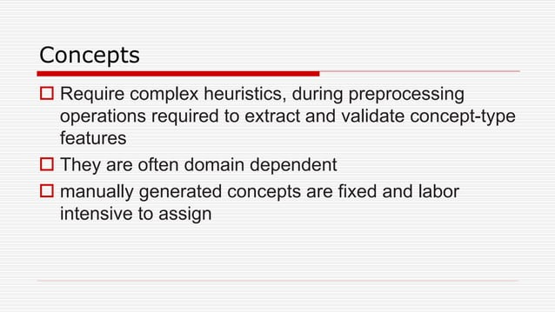

Slide 55
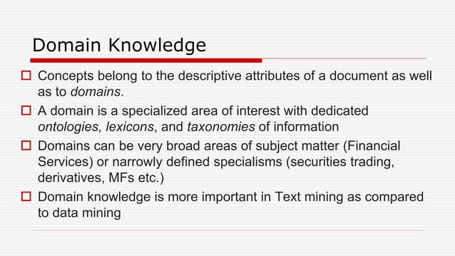

Slide 56
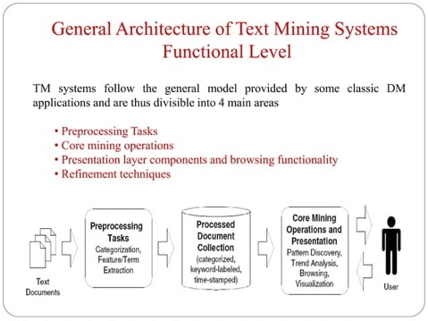

Slide 57
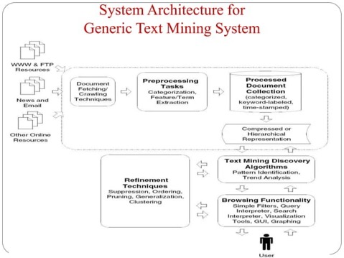

Slide 58
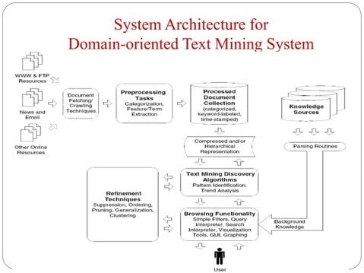

Slide 59
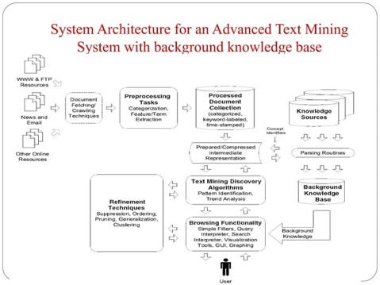

Slide 60
Machine Learning Applications in Text Categorization
The final element in the development of modern text mining systems was contributed (gradually) by machine learning (ML) technology.
ML began to be applied to text categorization studies in the early 1990s.
Before ML algorithms can be applied successfully to text documents, a set of input features (e.g., terms) must be defined, and all of the documents must be classified into one of a set of categories.
Then the classified training set can be submitted to the ML algorithm.
After the model is trained, unclassified documents can be submitted to the model for classification, using the patterns of the categories learned in the training operation.

Slide 61
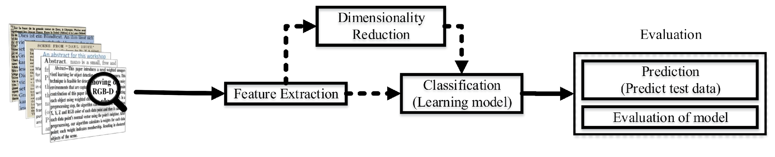
Machine Learning Text Categorization

Slide 62
Bag-of-Words versus High-Dimensional Vector Spaces
One of the most important advances in the early 2000s was the extension of the bag-of-words concept to a higher-dimensional space of “features” defined by nonlinear functions.
Kernel-based learning methods have been applied to various information extraction tasks.
For simple data representations (e.g., “bag-of- words”) in which features can be easily extracted, some basic kernel functions such as linear kernel, polynomial kernel, and Gaussian kernel are often used.
A kernel uses a nonlinear function to “map” text terms (words or phrases) to a higher-dimensional “feature space”.
Initially, the dot-product was used as a linear function to map terms into feature space.
Alternatively, different kernels can be defined by using different nonlinear functions in the mapping process.

Slide 63
Bag of Words
The biggest problem with modeling text is that it is unorganised, and most the machine learning and deep learning techniques prefer well defined numeric data.
They cannot work with raw text directly, therefore we have to convert text into numbers.

Slide 64
Bag of Words
A bag-of-words model, or BoW for short, is a way of extracting features from text for use in modeling, such as with machine learning algorithms.
The approach is very simple and flexible, and can be used in a myriad of ways for extracting features from documents.
A bag-of-words is a representation of text that describes the occurrence of words within a document. It involves two things:
A vocabulary of known words.
A measure of the presence of known words.
It is called a “bag” of words, because any information about the order or structure of words in the document is discarded.
The model is only concerned with whether known words occur in the document, not where in the document.

Slide 65
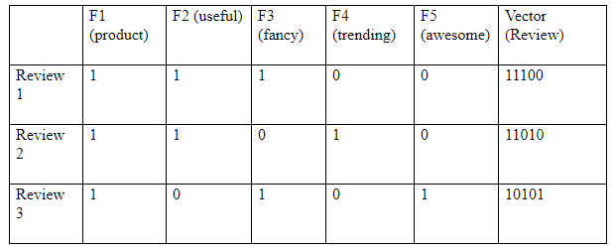
Bag of Words
Here’s a sample of reviews about a particular cosmetic product:
Review 1: This product is useful and fancy
Review 2: This product is useful but not trending
Review 3: This product is awesome and fancy

Slide 66
Limitations
First issue arises in cases when the new sentences contain new words. If such happens, then the vocabulary size would increase and thereby, the length of the vectors would increase too.
Additionally, the vectors would also contain many 0s, thereby resulting in a sparse matrix (which is what we would like to avoid)
Secondly, we are gaining no information about the grammatical section nor are we focussing on the order of words in text.

Slide 67
High Dimension Spaces
The total number of terms (words or phrases) used to characterize a document can become huge, creating very high-dimensional spaces for predictive analysis.
ML techniques like neural networks and decision trees must process high-dimensional spaces by learning to recognize patterns case by case.
Two challenges must be faced in analyzing data in high-dimensional text spaces.
The first challenge is the so-called curse of dimensionality (Bellman, 1957). As the number of variables increases, the complexity of algorithms to analyze them increases exponentially until they become intractable in many real-world applications.
The second challenge is that the absolute distance (and, therefore, the ability to discriminate) between the nearest neighbor and the farthest point diminishes as the dimensionality increases.
The challenge is to assign some metric of difference (or similarity) between points projected into the space. (Kernels)

Slide 68

ML Based Techniques – Text Categorization

Slide 69



Slide 70


Slide 71


Slide 72
SVM
An early ML approach to meet both challenges in high-dimensional space was to convert the effects of all variables in a record (or case) into a dot-product (or inner product) equal to the sum of the cross-products of each variable in two adjacent records in a list.
This inner product reflected the joint similarity between the two records.
In advanced data mining algorithms that function as kernel learning machines (e.g., support vector machines SVMs), the inner product is replaced by a kernel function that provides an expanded solution space.
The dot-product or kernel function also functions as a means to reduce the dimensionality from many variables to one (for a dot-product), or a very few for each record in an SVM, called support vectors.
This property renders SVMs relatively immune to the effect of the curse of dimensionality and commends SVMs for high-dimensional problems in text categorization.

Slide 73

Machine Learning – Supervised Learning

Slide 74

Machine Learning – UnSupervised Learning

Slide 75

Development Of Enabling Technology
Link Analysis
Link analysis is a form of association analysis, in which two or more entities (persons or activities, or things) are associated graphically with the presence of one or more “links” between two entities, and the strength of that link is depicted as lines of different thickness connecting the entities arranges along the circumference of a circle.

Slide 76
Development Of Enabling Technology
Reduction of Dimensionality and Feature Selection.
Processing text is a high-dimensional problem, even in applications where grammatical structure is ignored.
Computational developments have improved the scalability of text mining applications.
Sparse matrix methods have improved memory requirements and sped up computations.
The singular value decomposition has been extremely useful for reducing the dimensionality of problems.

Slide 77
Development Of Enabling Technology
Statistical approaches
HMMS, Sequence Labelling etc
Sophisticated Methods of Classification
Naïve Bayes methods, Rocchio Classification, and K-Nearest Neighbor.
Automation
Software availability, SAS, SPSS, Python R libraries . Toolkits

Slide 78
Development Of Enabling Technology
Many interesting applications and success stories

Slide 79

Knowledge discovery from text data
IBM’s Watson wins at Jeopardy! - 2011

Slide 80


An overview of Watson

Slide 81
What is inside Watson?
“Watson had access to 200 million pages of structured and unstructured content consuming four terabytes of disk storage including the full text of Wikipedia” – PC World
“The sources of information for Watson include encyclopedias, dictionaries, thesauri, newswire articles, and literary works. Watson also used databases, taxonomies, and ontologies. Specifically, DBPedia, WordNet, and Yago were used.” – AI Magazine

Slide 82
What is inside Watson?
DeepQA system
“Watson's main innovation was not in the creation of a new algorithm for this operation but rather its ability to quickly execute hundreds of proven language analysis algorithms simultaneously to find the correct answer.” – New York Times
The DeepQA Research Team

Slide 83

Text mining around us
Sentiment analysis

Slide 84

Text mining around us
Sentiment analysis

Slide 85

Text mining around us
Document summarization

Slide 86

Text mining around us
Document summarization

Slide 87

Text mining around us
Movie recommendation

Slide 88


Text mining around us
Restaurant/hotel recommendation

Slide 89

Text mining around us
News recommendation

Slide 90

Text mining around us
Text analytics in financial services

Slide 91


Text mining around us
Text analytics in healthcare

Slide 92
More Applications
Social network analysis
Multilingual text mining
Spam classification
Use of K-means clustering to group documents
Anomaly detection
Trend detection
Analysis of streaming text data

Slide 93

Text Analytics- Application Areas, Enabling Technologies

